Slide 1


Video Analytics based on Retail Consumer Behavior
VIDEO ANALYTICS CSE3043
Reuben Varghese Joseph | 19BAI1133
Anshuman Mohanty | 19BAI1156
Akhil Rudrawar | 19BAI1066
Soumyae Tyagi | 19BAI1126

Slide 2



Abstract
With recent advancements in video processing technology, we can now record subtle human behavior in a retail shop setting, which is crucial for business management. Customer behavior, when combined with specific demographic data, provides considerably more relevant business intelligence insights to the retail industry. It is key area for any retail scenario as shopping experience plays a vital role in ensuring the success of the company in the context of retail. Besides, it also helps predict which time of the day, a particular store is crowded, composition of male/female population visiting the store, predicting the preference of the customers and subsequently placing advertisements. In our work, we would be working on keeping track of real-time footfall analysis, demographic analysis on the basis of customer age groups and gender detection, traffic detection in particular sections of the shop and motion heatmaps to highlight the areas with the most customer traffic activity (i.e., hot zones). At the end of the work, the results generated suggested that the proposed system could be effectively employed in order to effectively support the analysis of customer experience in the context of retail.

Slide 3

Video analytics provides technical solutions to queries like "How many people visited my store today/this week/this month?" or "How many customers exhibited interest in the item on sale?"
Motivation
Information offers retailers with useful insights that allows them to enhance merchandising/marketing and improve the consumer experience, resulting in increased profitability.
Footfall analysis is a crucial metric for retailers because it enables them to compute the store conversion rate (i.e. the percentage of visitors converted to buyers). The conversion rate is an important metric for retailers because it indicates how well a store is functioning.
By having knowledge on hot zones, Store managers can optimize the layout of their stores for better product placement. This information can also be used to assess or improve the performance of sales or advertising displays.

Slide 4


Literature Survey
#1
Methodology
Highlights
Drawbacks
In 2018, Andrea Generosi, Silvia Ceccacci et al. proposed a deep learning framework to determine the customers’ age, sex, ethnicity and emotions by using convolution neural network which takes different frames of a video stream as input and provide an estimation of the aforementioned details.
The system is modular and does not implement any invasive solutions by allowing the monitoring of the emotive status of customers without being aware of it.
Easy and remotely accessible web based interface allows users to access data in a cloud based environment securely
The accuracy and effectiveness of the proposed frameworks are strongly affected by environmental conditions (e.g., illumination conditions, distance between customer and camera).

Slide 5
Literature Survey
#2
Methodology
Highlights
Drawbacks
In 2020, Earnest Paul Ijjina, Goutham Kanahasabai et al. proposed a deep learning framework for determining various demographics such as customer age, gender and expressions. Wide Residual Networks and Xception deep learning models was used to predict age, gender and facial expressions of consumers to devise effective marketing strategies in order to maximize sales.
The effectiveness of the proposed approach is evaluated on real-life garment store surveillance video, which is captured by low resolution camera, under non-uniform illumination, with occlusions due to crowding, and environmental noise. Using the proposed framework, a high accuracy is achieved.
The model achieves significantly higher accuracy when the subject faces towards the camera and the performance drops drastically when customers do not face the camera directly.

Slide 6
Literature Survey
#3
Methodology
Highlights
Drawbacks
In this paper Valerio Nogueira Jr., Hugo Oliveira et al. proposed a low-cost deep learning approach to real-time count of people in retail stores in real-time and visualize hot spots. They use a supervised learning strategy based on a CNN model to address the people counting problem by using RGBP image to clearly observe humans in the images.
Using merely a cheap security camera, this article proposed a low-cost deep learning strategy for estimating the number of people in retail outlets and detecting hot zones in real-time.
According to the findings, it is observed that a trained model cannot be used in many locations or views inside the same location. In other words, training is tailored to each location and point of view. To avoid viewpoint shifts, the surveillance camera must remain stationary.

Slide 7

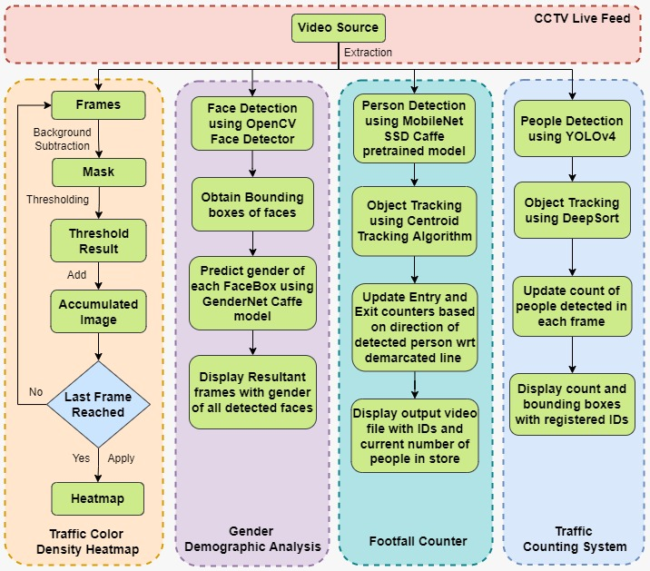
Project Design
ARCHITECTURE
This figure depicts the architecture of our project which includes four components. The first component, CCTV live feed deals with extracting frames from the real-time video surveillance which has been acquired. The frames are passed on to the modules presented in our framework namely, Motion heatmap for analyzing customer traffic patterns, Demographic analysis for detecting age and gender of consumers, and footfall counter for counting number of consumers .

Slide 8

Module
Description
Footfall Analysis
In this module, we would be measuring the footfall of people in a retail store. It would provide detailed analytics of the number of people who would be visible at different time intervals. Using this information, the retailers can get the peak hours of customer visits in the store. This module would be implemented by Reuben and Soumyae.
Customer age and gender detection
In this module we would be analyzing the demographic details of people in a retail store. Since customer demographics primarily dictate their preferences, identification and utilization of age & gender information of customers in sales forecasting, may maximize retail sales. We would draw a bounding box around the people and provide their approximate age group and their gender. This module would be implemented by Akhil and Anshuman.

Slide 9
Module
Description
Motion heatmap for analyzing customer traffic
In this module, we would analyze the customer traffic patterns in the retail store. It provides insights on where the traffic is concentrated in the store in the form of a color density heatmap. Using these statistics, the retailers can understand how to improve product placement and enhance the effectiveness of advertising displays. It will be implemented by Reuben, Soumyae, Anshuman and Akhil.
Traffic Counting system
In this module, we would count the number of people in a retail store in a specific section at a specific time. It would provide detailed analytics on the number of people visible at various time intervals in various sections. Using this information, retailers can determine the peak hours for customer visits to a specific section, sales of various products at different times of day, etc implemeneted by Reuben and Anshuman.

Slide 10
Dataset
We have collected our own dataset from a local store present within the university campus. The videos were captured from smartphones which were placed at an angle comparable to the ones provided by the CCTV cameras to depict the real-world scenario. One of the videos was taken facing towards the shelves and two other videos were captured facing towards the entrance. Each of the video clips were of roughly two minutes duration each.

Slide 11

Results

Slide 12
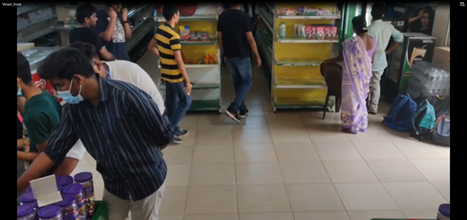
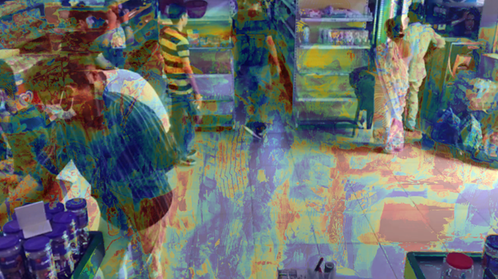
Motion heatmap for analyzing customer traffic
Original Video Clip Frame
Motion Heatmap Video Clip Frame

Slide 13
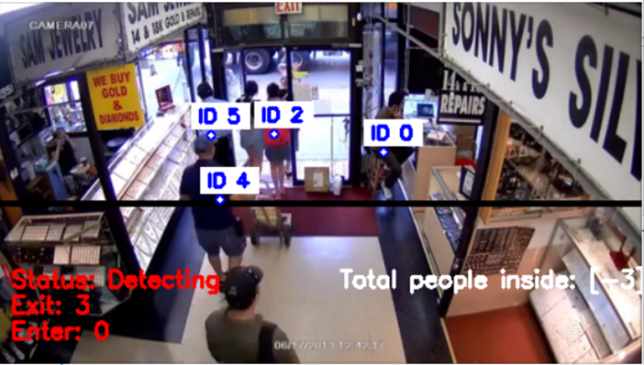
Footfall Counter
Footfall Counter with Entry and Exit count

Slide 14
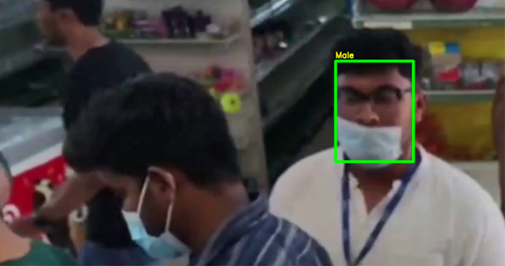
Gender Demographic Analysis
Gender Detection

Slide 15
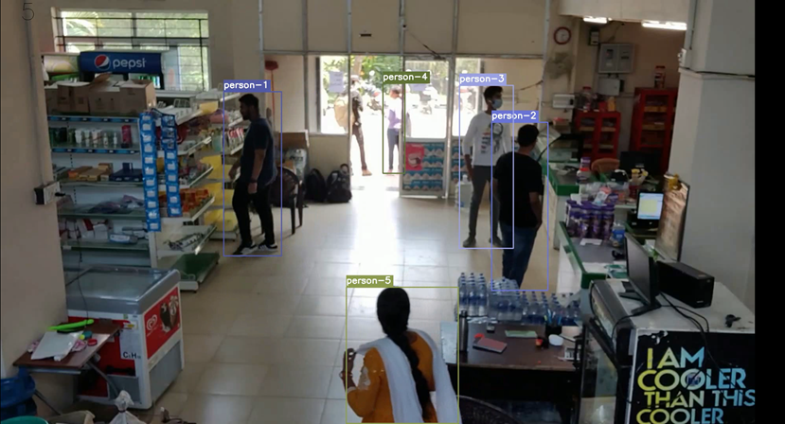
Traffic Counting System
Person Detection

Slide 16
Conclusion
Surveillance that is intelligent Video analysis has been used in a variety of fields, including transportation, security, and commerce. Object detection, particularly human detection, is the most important aspect of video analysis. Our work proposes a combined retail video analytics system comprising of four modules which cover the important aspects of retail stores such as advertisement placements, targeted marketing of products etc. It was an attempt to provide a low cost deep learning solution which could be integrated with the CCTV camera of the retail stores. The results obtained suggest that our approach tends to work well in the scenario of retail setting.

Slide 17

References
Generosi, A., Ceccacci, S., & Mengoni, M. (2018, September). A deep learning-based system to track and analyze customer behavior in retail store. In 2018 IEEE 8th International Conference on Consumer Electronics-Berlin (ICCE-Berlin) (pp. 1-6). IEEE.
Ijjina, E. P., Kanahasabai, G., & Joshi, A. S. (2020, July). Deep learning based approach to detect customer age, gender and expression in surveillance video. In 2020 11th International Conference on Computing, Communication and Networking Technologies (ICCCNT) (pp. 1-6). IEEE.
Silva, J. A., Nogueira Jr, V., Oliveira, H., Barbosa, A., Vieira, T., & Oliveira, K. (2021). Avaliação de abordagens para classificação automática de documentos jurídicos: um estudo comparativo aplicado a petições do Tribunal de Justiça do Estado de Alagoas. Proceeding Series of the Brazilian Society of Computational and Applied Mathematics, 8(1).

